Slide 1
Site Analytics HW By Google Analytics

Slide 2
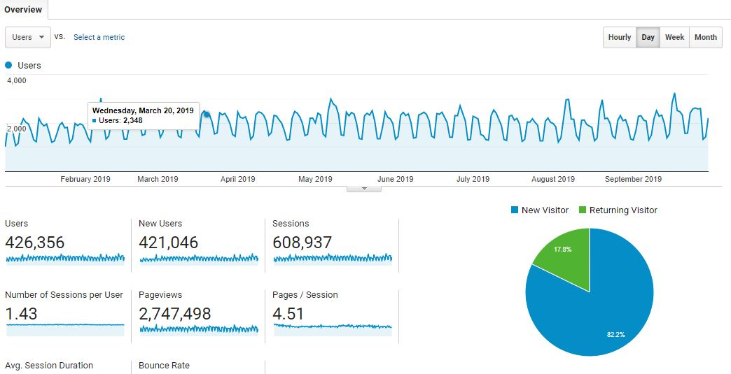
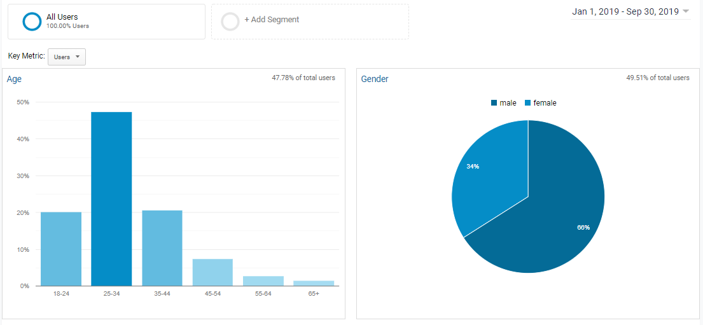
Audience Segmentation
Overview Analysis
Total User-426,356
New user-17.8%
Promoters-82.2%
Demographic Overview
Gender Ratio:-34:66
Age Range:18-65+ years
Highest User Age Range: 25-34 years

Slide 3
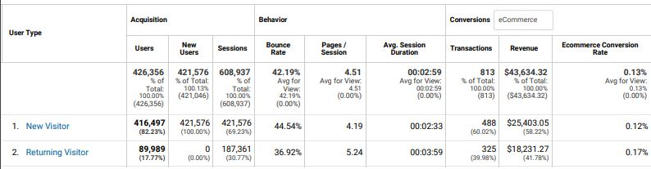
Audience Segmentation(Behavior)
Behavior Category
New vs. Returning
Frequency & Recency
Engagement
New vs. Returning
Summary
Total User-426,356
New user-416,497
Returning user-89,989
Bounce Rate (Avg)
Total User-42.19%
New user-44.54%
Returning user-36.92%
Page/Session
Total User-4.51
New user-4.19
Returning user-5.24
Revenue:
Total User-$43,634.32
New user-$25,403.05
Returning user-$18,231.27

Slide 4
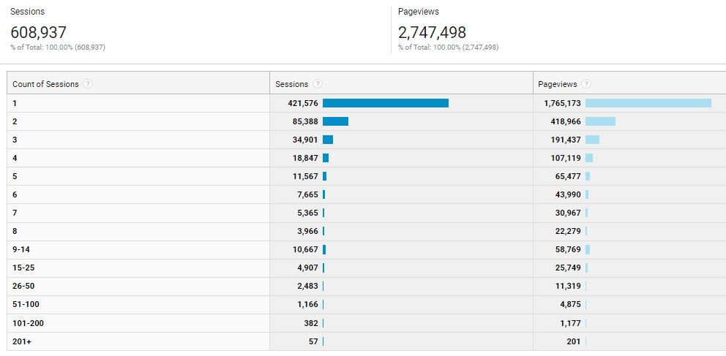
Audience Segmentation(Behavior)
Frequency & Recency
Summary
Total Session: 608,937
Total Pageviews: 2,747,498
Count of Session for 1, Sessions were created 421,576 (Highest) and no of page viewer were 1,765,173.

Slide 5
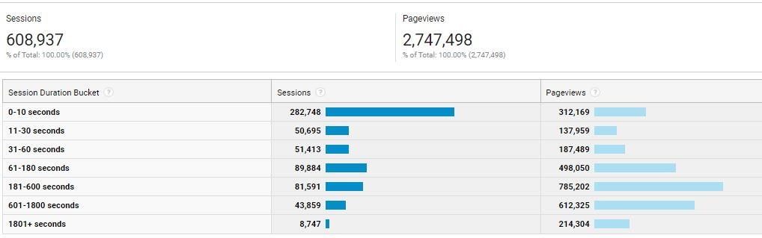
Audience Segmentation(Behavior)
Engagement
Summary
When Session Duration is 0-10 second, the no of sessions were created 282,748 and on that time page viewers were 312,169.
If Session Duration increases, no of Sessions were less created and also the pageviews were less.

Slide 6
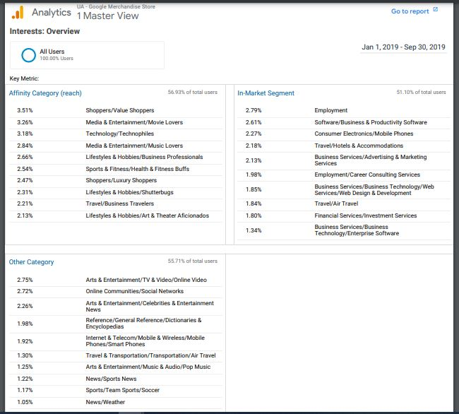
Audience Segmentation (Interest ) Cont.
Category
Affinity
In-Market Segment
Others
Affinity
High: Shoppers-3.51%
Low: Lifestyles & Hobbies-2.13%
Other Affinity Category is in between 3.51% to 2.13%.
In-Market Segment
High: Employment-2.79%
Low: Business Services-1.34%
Other In- Market Category is in between 2.79% to 1.34%.
Others
High: Arts & Entertainment-2.75%
Low: News/Weather-1.05%
People have interest in other category in between 2.75% to 1.05%.

Slide 7
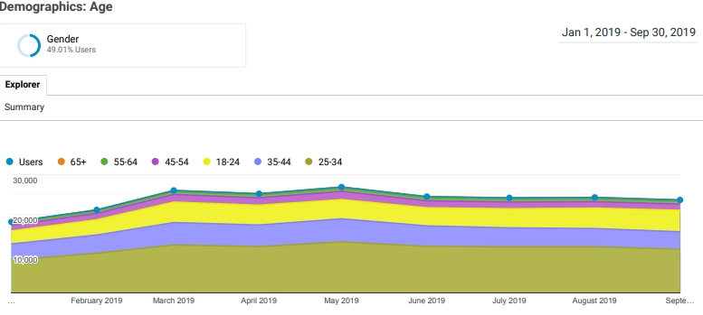
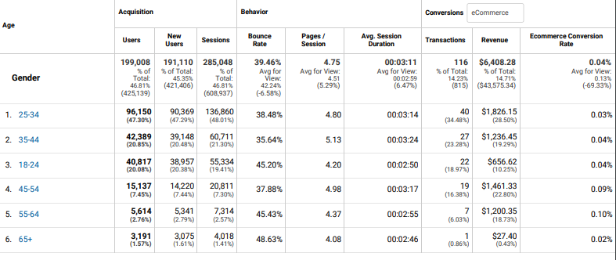
Audience Segmentation (Cont.)
The Age report shows that 25 -34 and 45-54 year-olds together make up the majority of users, but the 25-34 segment contributes the most revenue but age group 55-64 has the highest conversion rate.
Moreover, 25 -34 year-old age group is more active and they made highest purchase.

Slide 8
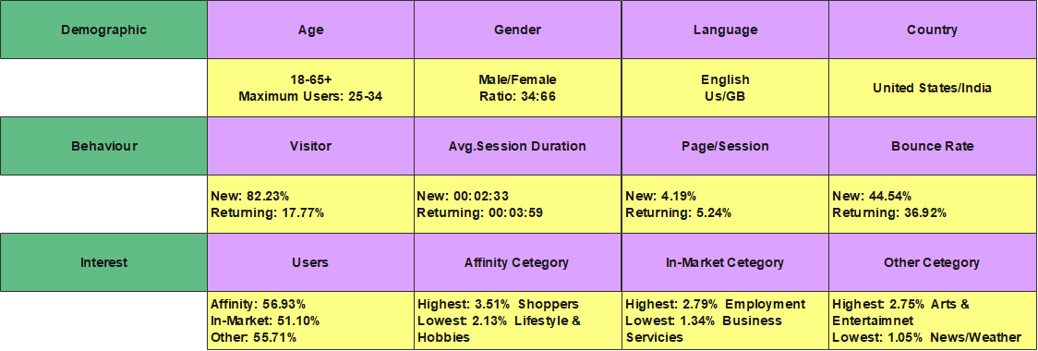
Audience Segmentation (At A Glance)

Slide 9
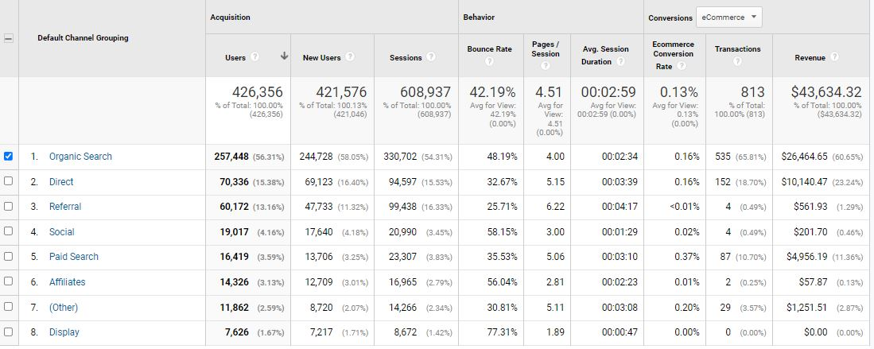
Acquisition Reports(Channel)
Category of Channels
1- Best : Organic Search
2- Medium: Direct
3- Low: Display
Revenue:
Organic Search: $26,454.65 (60.65% out of 100%)
Direct: $10,140.47 (23.24% out of 100%)
Display: $0.0 (0% out of 100%)
From all of the above channels, it may say that Organic Search and Direct channels create a large no of position in terms of transection and revenue in the given table.

Slide 10
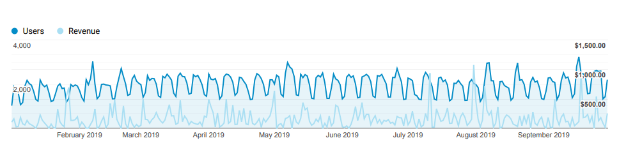
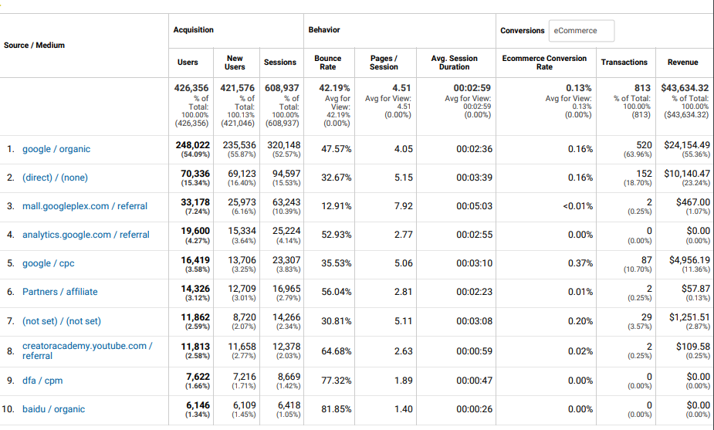
Acquisition Reports(Source/Medium)
User Vs Revenue
Source of Organic (Sorting by Revenue)
1- Google/ Organic -$24,154.49 (55.36%)/100%
2- Direct/ None -$10,140.47(23.24%)/100%
3- Baidu/Organic -$0.00(0.00%)/100%
In terms of revenue analysis, it may say that no of source/medium 1 & 2 are has a significant rate of total revenue.

Slide 11
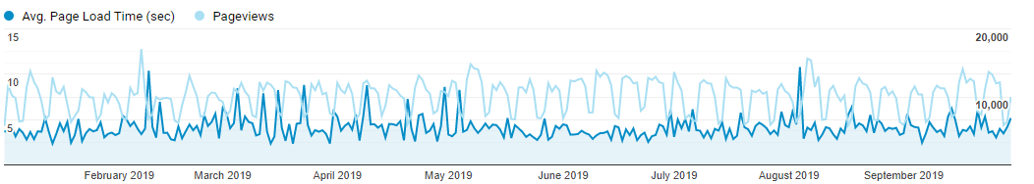
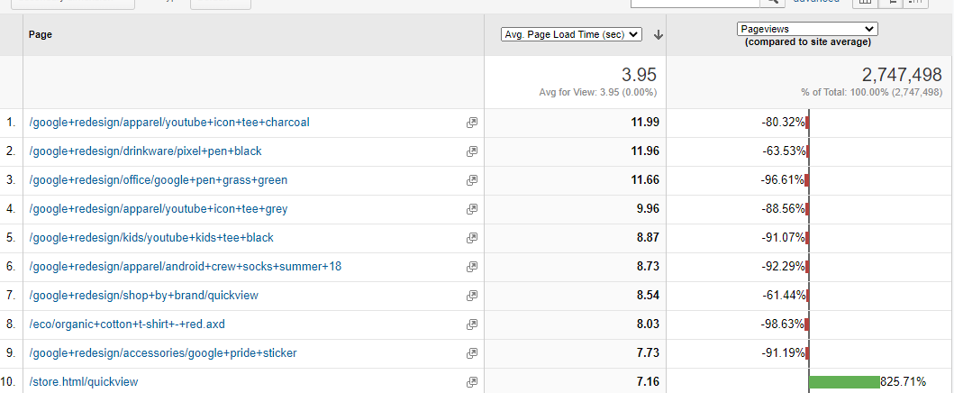
Page Timing Reports(Load Times)
Avg. Page Load Time Vs Page Views
Based on this data, we can conclude that when the site page load time is high, the page visits rate and page values are comparably low.
The average page load rate in Serial No. 1 is 11.99, indicating that the contents are identified as negative scale.

Slide 12
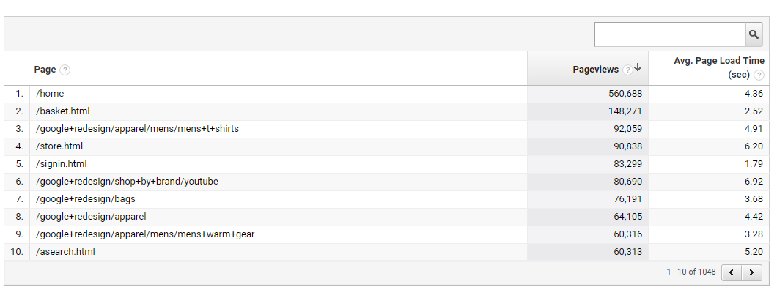
Page Timing Reports (Speed Suggestions)
From the Google analytics, when the avg. Page Load Time is lower, the Pageviews is comparatively higher.
For example, the homepage of the site is viewed higher where the avg page load time is 4.36Sec.
Moreover, the landing page ‘store’ shows higher page load time that is 6.20Sec and the pageview is 90,838.

Slide 13
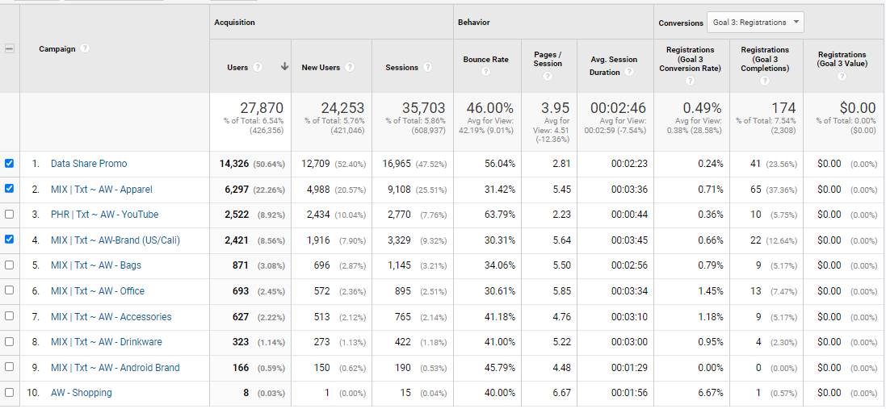
Acquisition(All Campaign Report)
Campaigns (Top Three)
Apparel
Promo
AW-Brand (US/Cali)
Settings with Goal 3-Registration Conversion criteria, it fills apparel, promo and AW-Brand (US/Cali) in the top list.
The top three campaigns earned the largest number of conversions to the objective, with the second and third placed campaigns also achieving the remaining targets.

Slide 14
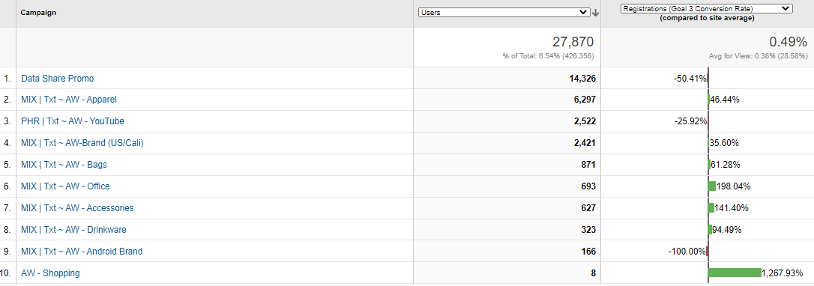
Acquisition(User vs Site Campaign Comparison )
According to Google Analytics, AW – Shopping had a large rate when compared to other site campaigns. Office & Accessories came in second and third place.
These comparison is made by Goal 3-Resigtration Conversion rate.
The Google Merchandise Store has a large number of paid keywords that are utilized in campaigns, with a rate of 39.01 %. It facilitates a large-scale presentation of the site to clients.

